Slide 1

UNIVERSITY COLLEGE OF ENGINEERING KANCHEEPURAM DEPARTMENT OF COMPUTER SCIENCE AND ENGINEERING
SECURE FILE STORAGE USING NEO-HYBRID CRYPTOGRAPHY
BATCH MEMBERS
1. Deepach Chandru M (513419104010)
2. Raghul J (513419104035)
3. Thillaivalavan A S (513419104049)
GUIDED BY – Mr. J. Devanathan M.Tech.,Teaching Fellow
‹#›
Notes:
‹#›

Slide 2
ABSTRACT
Security is a major concern in a wide range of applications, from cloud storage to messaging via chat.
Many different approaches have also been proposed to provide data protection in the cloud, such as AES, DES, and RSA, but Existing systems often fail when only a certain form of encoding is utilized, either AES, OR DES, OR RSA depending on a consumer requirement.
Cryptographic techniques such as DES and AES are used in order to provide Security to the data but using a single technique sometimes doesn’t provide high-level security.
So here the proposed work focused on introducing a hybrid cryptographic mechanism that involves multiple techniques to encrypt and decrypt the data.
‹#›
Notes:
‹#›

Slide 3
AIM / OBJECTIVE
To build a Hybrid Crypto-system that secures data on multiple layers and also ensures security of keys.
To store the keys securely so that they don’t lead to any vulnerabilities.
creation of a crypto-system that provides excellent security without compromising on performance and speed.
To overcome the performance-security tradeoffs of cryptographic algorithms when used separately.
‹#›
Notes:
‹#›

Slide 4
LITERATURE REVIEW
S.NO | TITLE | AUTHOR | PUBLICATION AND YEAR | DRAWBACK
1 | Design of a secure virtual file storage system on cloud using hybrid cryptography | Bello.A.Buhari,Aliyu Mubarak,Bello A.Bodinga,Muazu D.sifawa, Muaza D.sifawa | IEEE, 2022 | Only AES is used for encryption and SHA-2 for checking the integrity
2 | A Comprehensive Study of Digital Image Steganography Techniques | Shahid rahman , Jamaludeen, Muhammed Zakarya (Senior Member, IEEE),Hameed hussain | IEEE, 2023 | The comprehensive study of steganography tells us about data hiding techniques and its complexities.
3 | Secure File Storage on Cloud using Hybrid Cryptography | Vivek Sharma, Abhishek Chauhan, Harsh Saxena, Shubham Mishra, Sulabh Bansal | IEEE, 2021 | 3-DES and Blowfish algorithms is used , key are not secured in the system

Slide 5
LITERATURE REVIEW
S.NO | TITLE | AUTHOR | PUBLICATION AND YEAR | DRAWBACK
4 | Secure File Storage using Hybrid Cryptography | Putta,Bharathi,Gayathi Annam,Anjali and Vamsi Krishna Duggana | IEEE, 2021 | It uses AES,DES and RSA algorithms for encryption and decryption but each of them are old and known for vulnerabilities
5 | Data Using Efficient Combination of RSA Cryptography | Osama fouad, Abdel wahab, Ashraf A. M. khalaf | IEEE, 2021 | This methodology mainly focuses on data compression using RSA and Huffman coding algorithm.There is no key management
6 | Hybrid Cryptography for Cloud Computing | Heena Kausar Khan, Rubika Pradhan, B. R. Chandavarkar | IEEE, 2021 | They applied AES and ECC for encryption and E-LSB steganography for data hiding in the cloud its is faster but can be improved

Slide 6
SUMMARY OF LITERATURE SURVEY
Only one encryption technique is used, and keys are not effectively supervised, there is a risk of key leakage.
Due to weak random number generator of RSA, it takes comparatively lesser time of cracking the algorithm.
Various combinations of Advanced Encryption Standard (AES), Elliptical Curve Cryptography (ECC) and Rivest, Shamir and Adleman (RSA) algorithms are used to provide hybrid encryption. Secure Hash Algorithm (SHA-256) is also used to provide authentication and integrity, but the combinations are less effective.
The most common hybrid system is based on the Diffie-Hellman key exchange, which is a method for exchanging private keys using public-key encryption.
AES, DES or RSA methods are used for encryption and the key sharing process is not secure.
‹#›

Slide 7
PROPOSED WORK
The proposed system, When a user uploads data, it is divided into five sections, the first of which is encrypted with AES, the second with BlowFish, the third with Triple-DES, the fourth part with IDEA and the fifth part with Fernet Algorithm.
LSB steganography is used to store the keys in the image, and the encrypted files are stored in the cloud.
Users must first recover the keys from the image before they can import all data from the server.
These keys are then used to decrypt the data once more with AES, Triple-DES, BlowFish, IDEA and Fernet
This approach increases the security of records.
‹#›

Slide 8
PROPOSED SYSTEM ADVANTAGE
Instead of DES, the system uses Triple-DES. Where it has three keys, the data is first encrypted with Key1 and then decrypted with Key2 and then encrypted back with Key3, which provides more security than DES.
Using BlowFish Algorithm rather than RSA, Blowfish is speedy enough to use on large documents, while RSA is pretty slow and therefore mostly used on small bits of data.
The largest Blowfish keys (448 bits) are significantly smaller than the smallest RSA keys (1024 bits)
The Keys and Encrypted files are then embedded in a cover image using LSB Steganography provides secure data transfer.
‹#›

Slide 9
SYSTEM MODULES
The system modules consists of
Data Pre-processing
Cryptography Algorithm
Steganography
Decryption and Extraction
‹#›

Slide 10
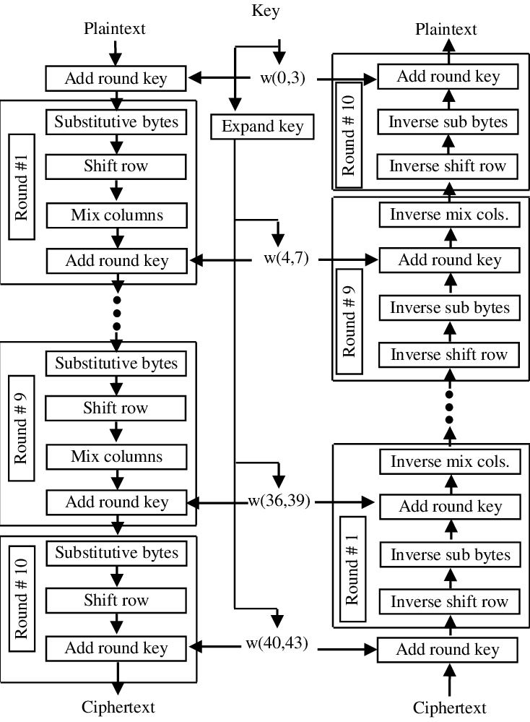
ALGORITHMS / TECHNIQUES USED
ADVANCED ENCRYPTION STANDARD(AES)
function AES_Encrypt(plaintext, key):
state = plaintext
round_key = key
AddRoundKey(state, round_key)
for round in 1 to 10:
SubBytes(state)
ShiftRows(state)
MixColumns(state)
AddRoundKey(state, round_key)
return state

Slide 11
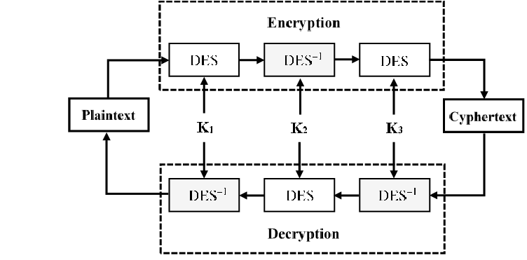
ALGORITHMS / TECHNIQUES USED
TRIPLE-DATA ENCRYPTION STANDARD(3-DES)
function TripleDES_Encrypt(plaintext, key1, key2, key3):
ciphertext = DES_Encrypt(plaintext, key1)
ciphertext=DES_Decrypt(ciphertext, key2)
ciphertext=DES_Encrypt(ciphertext, key3)
return
ciphertext function DES_Encrypt(data, key):
# Perform DES encryption
# ... function
DES_Decrypt(data, key):
# Perform DES decryption

Slide 12
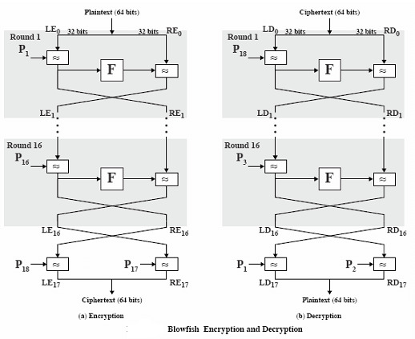
ALGORITHMS / TECHNIQUES USED
BLOWFISH ALGORITHM
function Blowfish_Encrypt(plaintext, key):
left = extract left half of plaintext
right = extract right half of plaintext
for round in 1 to 16:
left = left XOR round key
right = F-function(right) XOR left
swap left and right
swap left and right
right = right XOR round key
left = left XOR round key
ciphertext = concatenate left and right
return ciphertext

Slide 13
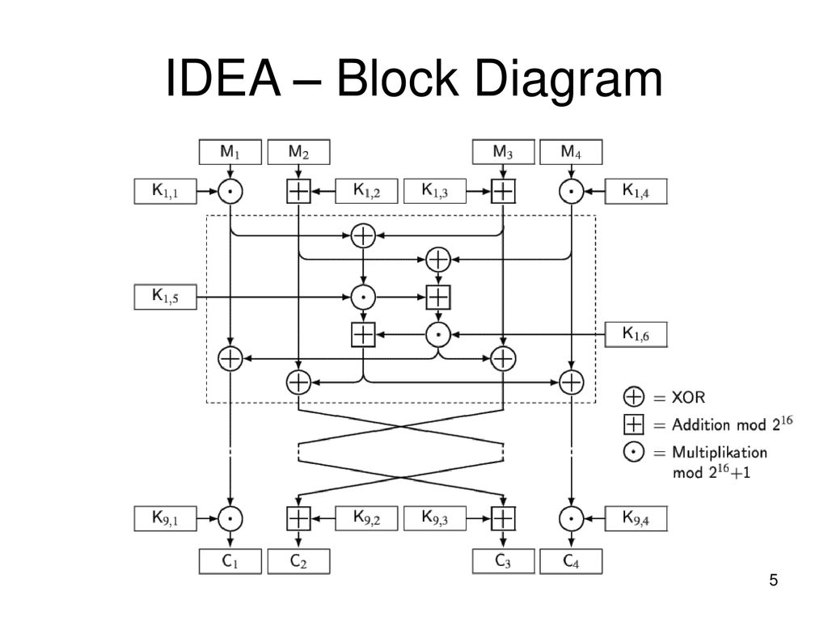
ALGORITHMS / TECHNIQUES USED
INTERNATIONAL DATA ENCRYPTION ALGORITHM (IDEA)
function IDEA_Encrypt(plaintext, key):
plaintext_words = SplitPlaintextIntoWords(plaintext)
key_words = SplitKeyIntoWords(key)
for round in 1 to 8:
plaintext_words =RoundFunction(plaintext_words, key_words,round)
plaintext_words=LastRoundFunction(plaintext_words, key_words)
ciphertext = CombineWordsIntoCiphertext(plaintext_words)
return ciphertext

Slide 14
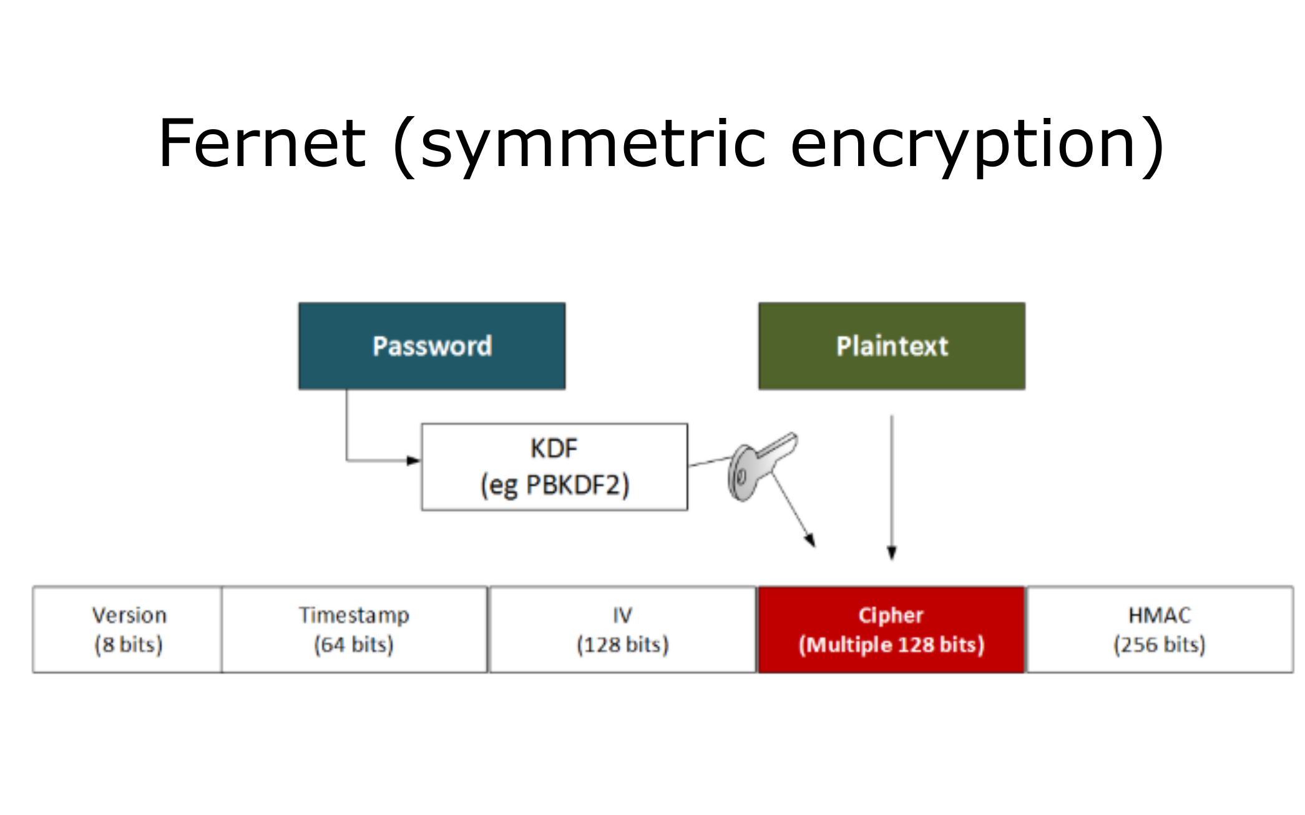
ALGORITHMS / TECHNIQUES USED
FERNET ALGORITHM
function Fernet_Encrypt(plaintext, key):
generate random 128-bit Initialization Vector
encryptor = AES_Encryptor(key)
ciphertext = encryptor.encrypt(IV + plaintext)
return IV + ciphertextfunction Fernet_Decrypt(ciphertext, key):
IV = extract IV from the beginning of ciphertext
encryptor = AES_Encryptor(key)
plaintext = encryptor.decrypt(ciphertext)
return plaintext[16:]

Slide 15
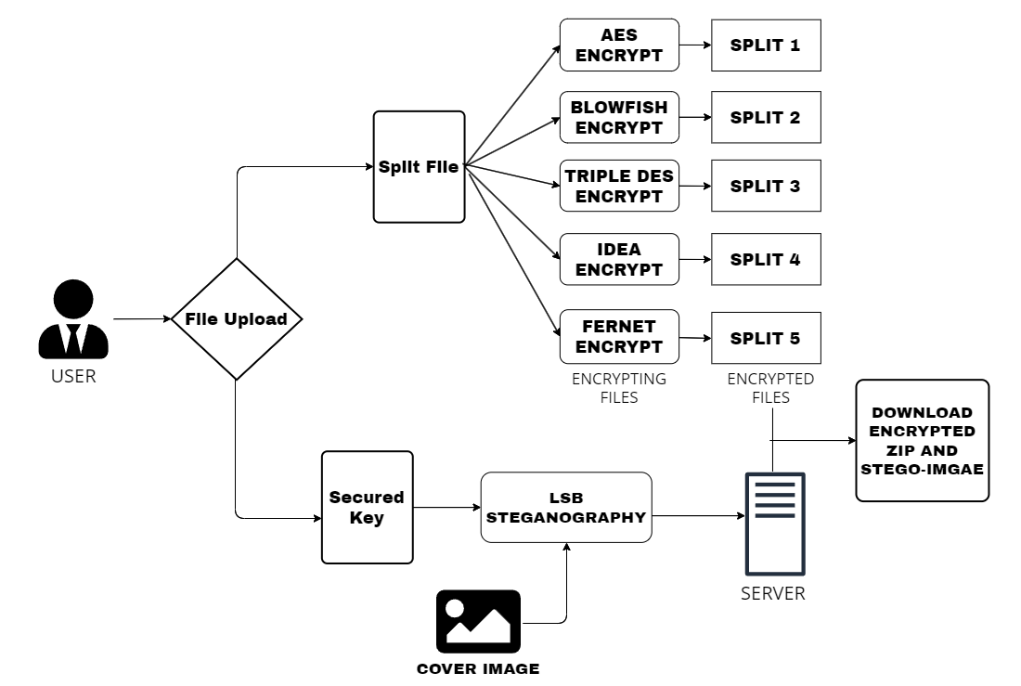
SYSTEM / ARCHITECTURE DIAGRAM ENCRYPTION

Slide 16
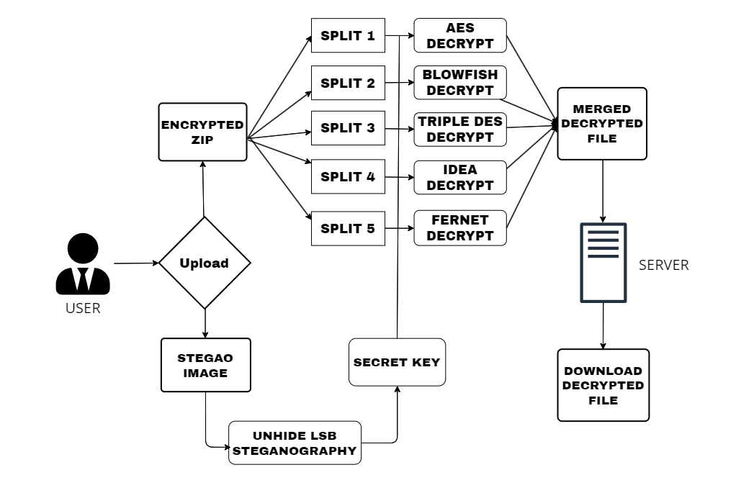
SYSTEM / ARCHITECTURE DIAGRAM DECRYPTION

Slide 17
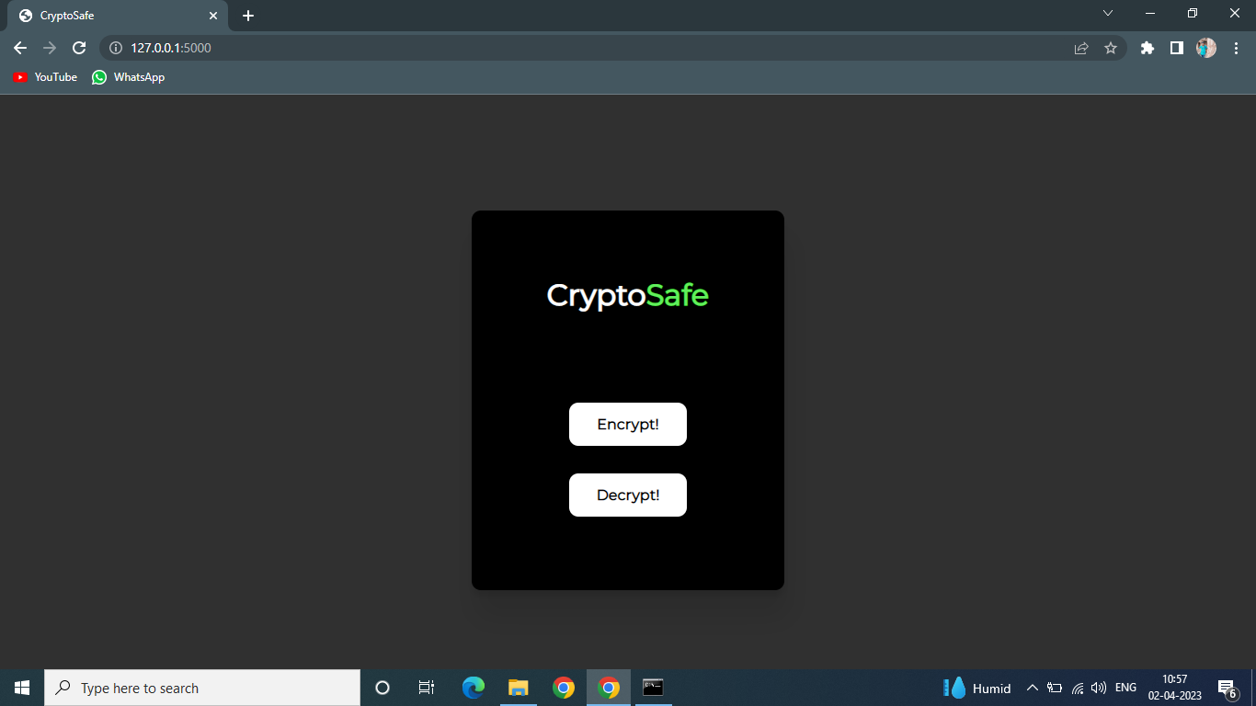
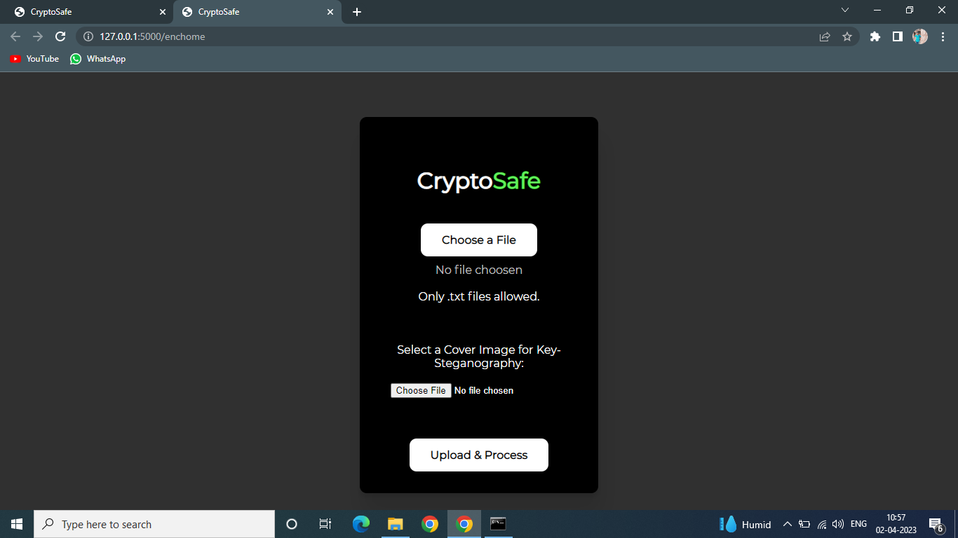
RESULT

Slide 18
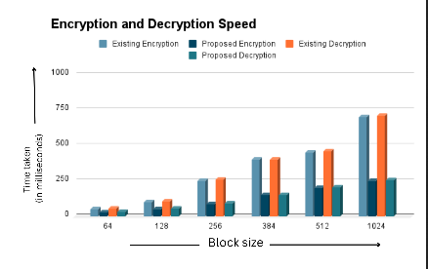
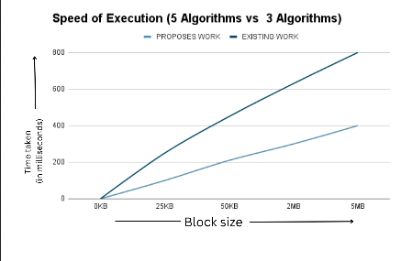
PERFORMANCE EVALUATION

Slide 19
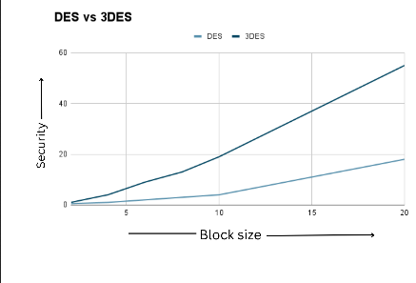
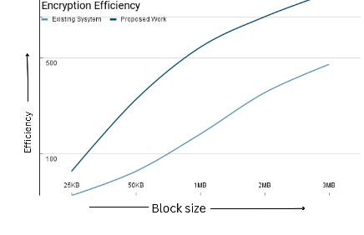
PERFORMANCE EVALUATION

Slide 20
CONCLUSION / FUTURE WORK
The proposed cryptosystem uses a combination of symmetric cryptography to secure data.
The system also introduces a sub-process to encrypt the keys used for encryption before embedding them in an image.
The combination of Blowfish, AES, TripleDES has significantly improved the security and also ensured that the drawbacks of the standalone systems are addressed.
The system also helps in improving security without the use of keys of larger lengths
System is now designed only for text based files. Future work is to make the system capable of supporting audio, video, many other file formats.
‹#›

Slide 21
REFERENCES
[1] Chinnasamy, P., Padmavathi, S., Swathy, R., & Rakesh, S. (2021).Efficient Data Security Using Hybrid Cryptography on Cloud Computing. In Inventive Communication and Computational Technologies (pp. 537-547). Springer, Singapore.
[2] Rose Adee1 and Haralambos Mouratidis (2022) “A Dynamic Four-Step Data Security Model for Data in Cloud Computing Based on Cryptography and Steganography”Sensors 1109. https://doi.org/10.3390/s22031109.
[3] Secure File Storage Using Hybrid Cryptography: 2021 6th International Conference on Communication and Electronics Systems (ICCES) Authors:Putta Bharathi, Gayathri Annam, Jaya Bindu,Kandi Vamsi,Krishna Duggana and Anjali.T.
4] Exploring LSB Steganography Possibilities in RGB Images: 2021 12th International Conference on Computing Communication and Networking Technologies Authors: Rutvik Dumre and Aashka Dave.
[5] Combined Cryptography and Steganography for Enhanced Security in Suboptimal Images: 2020 International Conference on Artificial Intelligence and Signal Processing (AISP)Authors:S. Joseph Gladwin and Pasumarthi Lakshmi Gowthami
‹#›

Slide 22
THANK YOU

